Slide 1

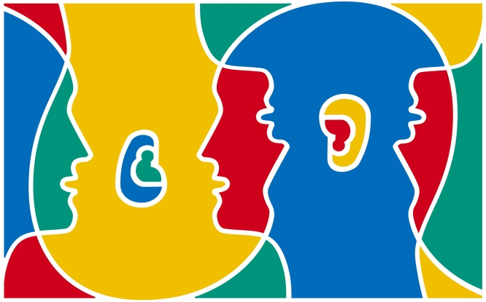


European Day of Languages
26 September
Think
Discuss
Write

Slide 2
History & Aims of EDL
Since 2001, when the European Year of Languages was launched by the Council of Europe and the European Union, EDL has been celebrated around the world each year on the 26th September.
It is a day to celebrate the rich diversity of languages spoken by the 800 million people who are now living in Europe and represented in the Council of Europe’s 47 member states.
On EDL you should reflect on the advantages of language competence and life-long language learning.

Slide 3
Celebrations for EDL
Around the world and even in your own local community, people will be organising and running events to celebrate EDL
People are encouraged to learn a new language, take part in games and events to celebrate language learning
TV and radio programmes, talks and conferences will be dedicated to languages

Slide 4
Some facts about languages in our schools in N Ireland
Last year, after French, Spanish, Irish and German, the most popular language taken at GCSE was Polish, and at A-level it was Chinese!**
Last year, over 130 people took a GCSE and 84 people took an A-level in a language other than French, Spanish, Irish and German!**
More girls opted to take a
language at GCSE or A-level last year**
There are lots of lesser-known languages spoken and used throughout N Ireland, including Marathi, Igbo, Kannada and Gujarati!*
Since 2001, the number of newcomer pupils (whose 1st language is not English) in our schools has risen from 1366 to almost 10,500!*
There are over 5,000 young people in N Ireland who attend Irish-medium schools*
* 2014/15 NI Schools Census
** RM Education

Slide 5
Some interesting facts.
Can you fill in the gaps?
There are over ……1………young people in N Ireland whose 1st language is not English!*
……2……… is the most widely spoken mother-tongue language amongst our new-comer young people, followed by Lithuanian and ……………3……………!*
There are …4…. official languages in the EU but over …5….. European languages spoken and used every day.
The very 1st official language policy identified Dutch, French, ..…6……., and Italian as the official working languages of the EU.
……7………… languages, such as Catalan and ……8….., have gained a status as co-official languages of the European Union.
There are around …9… minority and regional languages spoken in the European Union, as well as more than ……10… migrant languages.
The EU prioritises language learning and one of its policy objectives is that every European citizen should master …11. other languages in addition to ……12………..
Regional
24
Polish
2
60
10,000
Portuguese
200
Welsh
175
German
* 2014/15 NI Schools Census
their mother tongue

Slide 6
Some interesting facts.
Can you fill in the gaps?
10,000
There are over ……1………young people in N Ireland whose 1st language is not English!*
……2……… is the most widely spoken mother-tongue language amongst our new-comer young people, followed by Lithuanian and ……………3……………!*
There are …4…. official languages in the EU but over …5….. European languages spoken and used every day.
The very 1st official language policy identified Dutch, French, ..…6……., and Italian as the official working languages of the EU.
……7………… languages, such as Catalan and ……8….., have gained a status as co-official languages of the European Union.
There are round …9 minority and regional languages spoken in the European Union, as well as more than ……10… migrant languages.
The EU prioritises language learning and one of its policy objectives is that every European citizen should master …11. other languages in addition to ……12………..
Polish
Portuguese
24
200
German
Regional
Welsh
60
175
2
their mother tongue
Regional
24
Polish
2
60
10,000
Portuguese
200
Welsh
175
German
* 2014/15 NI Schools Census
their mother tongue

Slide 7
Do you know what these key linguistic terms mean?
Monolingual
Bilingual
Multilingual/ Plurilingual
Dialect
Colloquial
Linguistic
Lexis
Minority-language
Migrant-language
Eurobarometer
Diversity
Speaking only 1 language
Fluency in 2 languages
Fluency in several languages
Particular language of specific region or community
Non-formal language used in familiar or ordinary conversation
Linked to language
Words and idioms that make up vocabulary in a language
Language used by minority of people in a territory
Language used people who have recently arrived in a territory
Public-opinion survey of the European Commission
Range of different things

Slide 8
The following are names of EU member states in their own native tongue. Can you guess what they are?
Nederland
Deutschland
Slovenija
Éire
Suomi
Eesti
Slovensko
Sverige
Magyarország
Ελλάδα (Elláda)
Holland/Netherlands
Germany
Slovenia
Ireland
Finland
Estonia
Slovakia
Sweden
Turkey
Greece

Slide 9
Video clip
‘Hello. Talk to me!’
Listen and watch people saying ‘Hello. Talk to me!’ in different languages.
How many languages can you recognise?

Slide 10
‘Hello!’
What language is this?
Ciao
Hallo
Hej/Goddag
γεια σαςγεια σας(geia sas)
Olá
ہیلو (Assalam Aleykum)
Hujambo
Helô
Tere
Ahoj
Italian
Dutch/German/Afrikaans
Danish
Greek
Portuguese
Urdu
Swahili
Welsh
Estonian
Czech

Slide 11
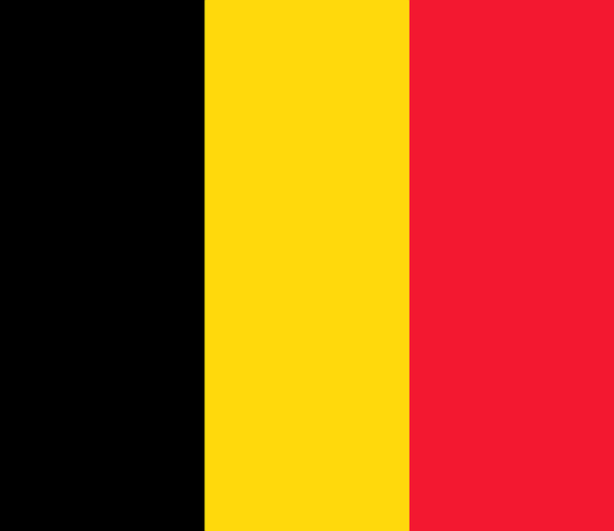
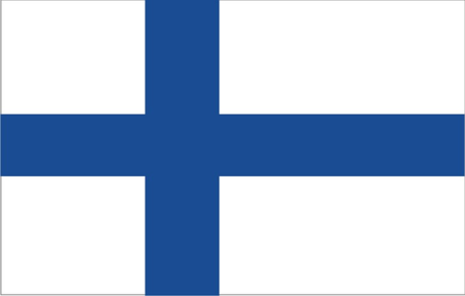
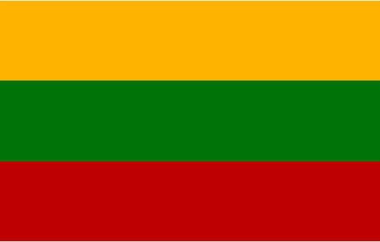
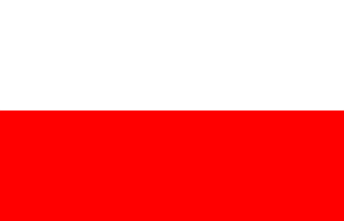
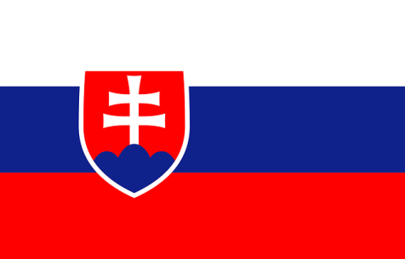
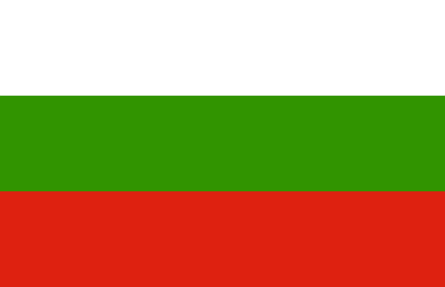
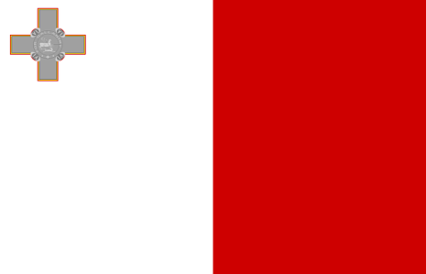
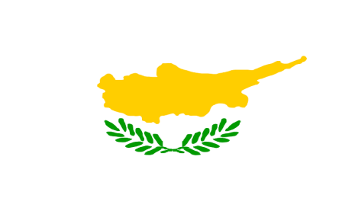
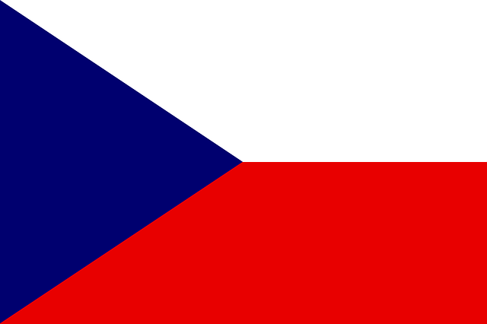
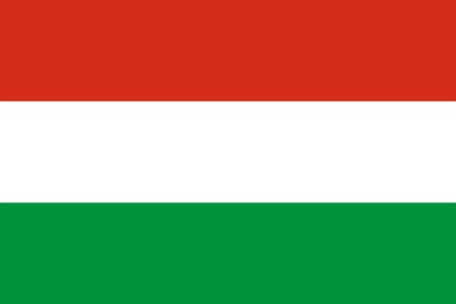
Do you know which EU member states these flags belong to?
1
2
3
4
5
6
7
8
9
10

Slide 12
Do you know which EU member states these flags belong to?
1. Belgium
2. Finland
3. Lithuania
4. Poland
5. Slovakia
6. Bulgaria
7. Malta
8. Cyprus
9. Czech Republic
10. Hungary

Slide 13
Fact or fiction?
Read the following statements about languages in the EU and decide if they are fact or fiction!
1. The national language of Austria is German
2. There are 2 official languages in Finland: Finnish and Swedish
3. There are 2 official languages in Belgium: Flemish and German
4. There are 2 official languages in Luxembourg : French and German
5. The main language spoken in Spain is Castilian
6. Arabic, Chinese and Hindi are the main non-European languages most widely used on European territory
7. In London around 200 languages are spoken
8. Most of the official EU languages are Indo-European
9. Russian is one of the official languages of the EU
10. English is spoken by more than half the entire population of the EU

Slide 14
Fact or fiction?
Read the following statements about languages in the EU and decide if they are fact or fiction!
Fact-But there are also many regional languages and minority languages
1. The national language of Austria is German
2. There are 2 official languages in Finland: Finnish and Swedish
3. There are 2 official languages in Belgium: French and German
4. There are 2 official languages in Luxembourg: French and German
5. The most widely used language in Spain is Castilian
6. Arabic, Chinese and Hindi are the main non-European languages most widely used on European territory
7. In London around 200 languages are spoken
8. Most of the official EU languages are Indo-European- Fact
9. Russian is one of the official languages of the EU
10. English is spoken by more than half the entire population of the EU
Fact
Fiction- There are 3: French, German and Dutch. Flemish is also considered a regional language.
True- Luxembourgish is also considered one of its regional languages
Fact
Fact
Fiction (Around 300 languages are spoken)
Fact- Meaning relating to the family of languages spoken over the greater part of Europe and Asia
Fiction-but it is the sixth most common language, after English, French, German, Spanish, and Italian.
Fact-but German has the most native speakers

Slide 15
Some inspirational quotes about language learning…
Which is your favourite? Do you have your own?
‘He who knows no foreign language knows nothing of his own’ Ludwig von Goethe
‘If you talk to a man in a language he understands, that goes to his head. If you talk to a man in his own language, that goes to his heart’ Nelson Mandela
‘A different language is a different vision of life’ Federico Fellini
‘Writing cannot express all words, words cannot encompass all ideas’ Confucius
‘Language is the laughter of the soul’ Pablo Neruda
‘To have a 2nd language is to possess a 2nd soul’ Charlemagne

Slide 16
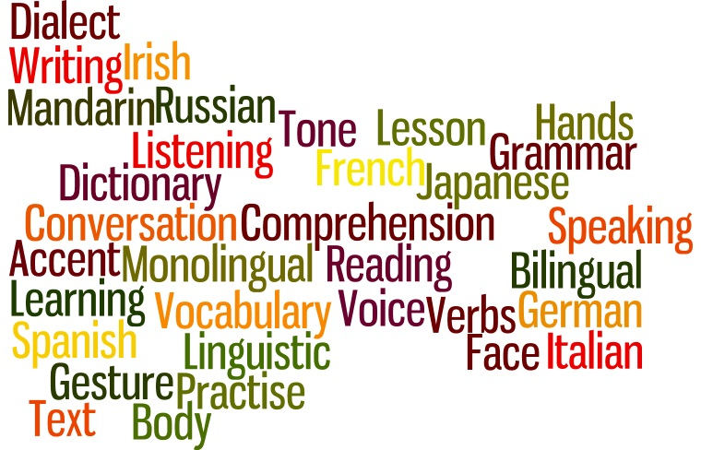
Now create your own word cloud about languages!

